Slide 1

Threadlooms knits
S MAKAVISHNU
III CS B
24CS108

Slide 2
Introduction
Threadloom Knits is a knitwear manufacturer in Tiruppur, Tamil Nadu, founded in 2008.
It makes T-shirts, polos, hoodies, kids' wear and corporate uniforms, and exports to 14 countries.
Purpose of the website: present the company, list products with bulk prices, and let buyers send enquiries.
Target users: bulk buyers, export agents and corporate clients.

Slide 3
Objectives
Give the site a professional look that suits a textile company
Make it responsive on phones, tablets and desktops
Use semantic HTML5 for clean, meaningful structure
Add JavaScript for interactivity and form validation
Support accessibility and search visibility
Structure the code so a backend and database can be added later

Slide 4
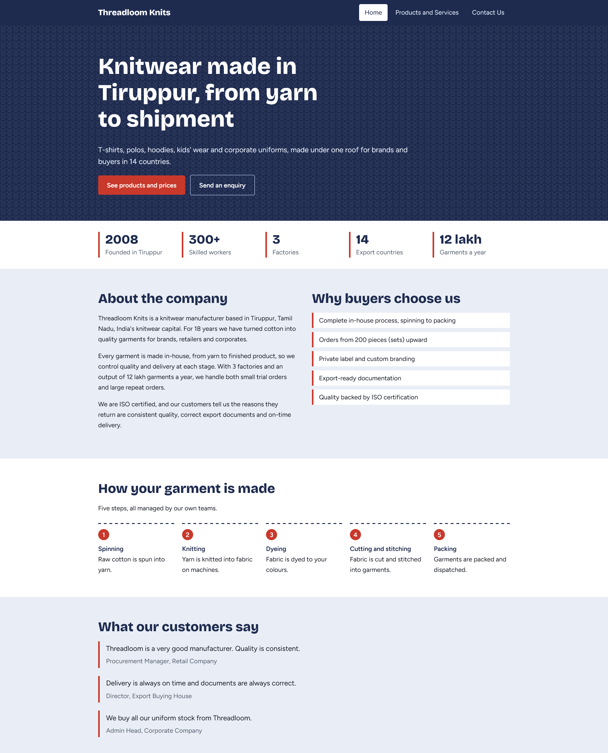
Home page
Hero section: headline, short intro and two call-to-action buttons (products and enquiry)
Stats strip: 2008, 300+ workers, 3 factories, 14 countries, 12 lakh garments a year
About the company: company story, plus a "Why buyers choose us" list
Process: the 5 steps (Spinning → Knitting → Dyeing → Cutting and Stitching → Packing) as a numbered sequence
Testimonials: three customer quotes, marked up with <blockquote> and ``
Closing call to action: "Planning an order?" with a quote button

Slide 5
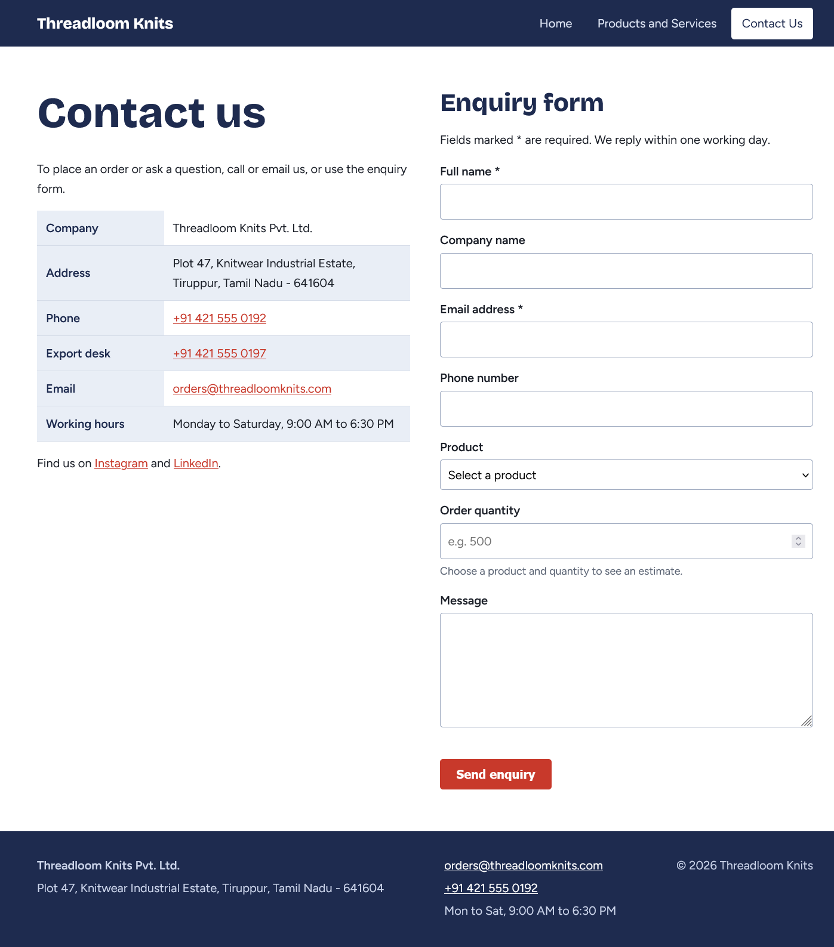
Contact page
Left side: company details table with clickable tel: and mailto: links, and the export desk number
Right side: the enquiry form (full name, company, email, phone, product, quantity, message)
Live features: a price estimate and a minimum-order check (covered on the next slides)
The layout is two columns on desktop and one column on mobile.

Slide 6
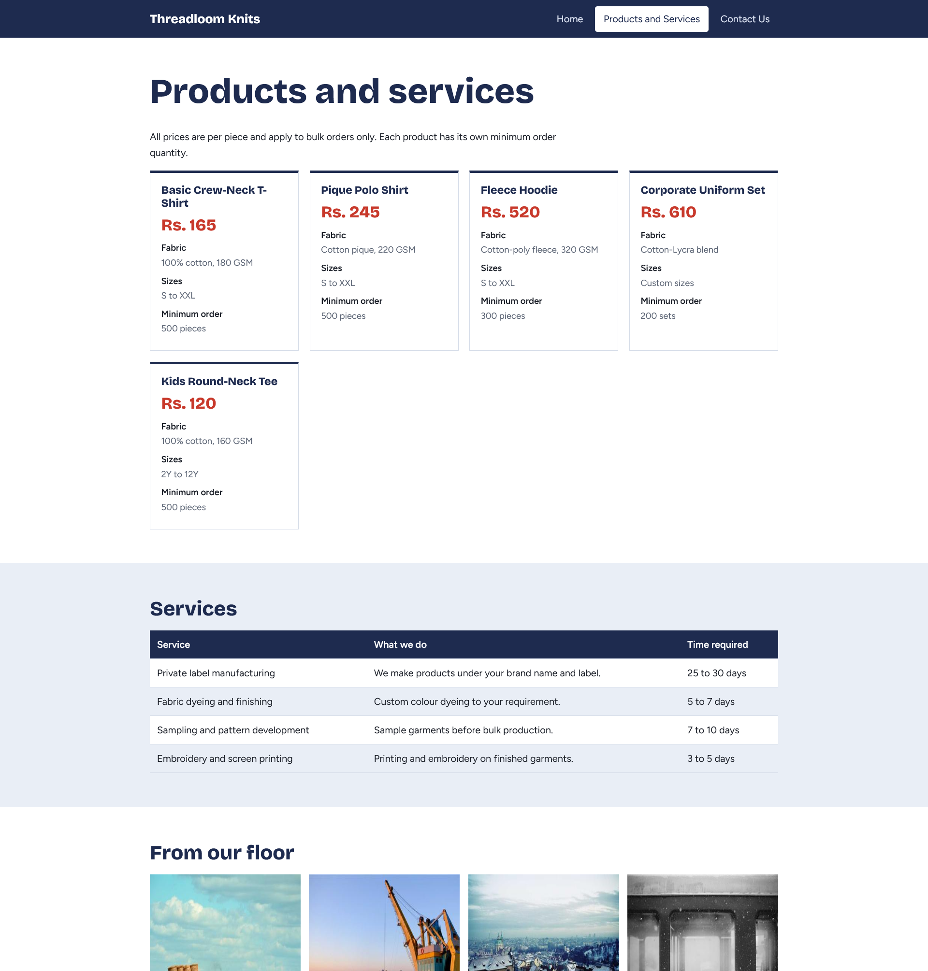
Products and Services page
Products are shown as cards with name, price, fabric, sizes and minimum order.
Five products, priced from Rs. 120 to Rs. 610 per piece:
  Basic Crew-Neck T-Shirt: Rs. 165
  Pique Polo Shirt: Rs. 245
  Fleece Hoodie: Rs. 520
  Corporate Uniform Set: Rs. 610
  Kids Round-Neck Tee: Rs. 120
Services table: Private Label Manufacturing, Fabric Dyeing and Finishing, Sampling and Pattern Development, Embroidery and Screen Printing, each with its lead time
The table scrolls sideways on small screens.
Gallery of 4 images with captions, using <figure>, <figcaption> and lazy loading.

Slide 7
Semantic HTML5 and attributes
Area | Used
Page structure | <header>, <nav>, <main>, <section>, <article>, <footer>
Content | <dl>, <ol>, <blockquote>, <cite>, <figure>, <figcaption>
Head | lang, <meta charset>, <meta name="viewport">, <meta name="description">
Forms | for/id labels, autocomplete, min, required, novalidate
Tables | <thead>, <tbody>, scope="row"
Images | alt, width, height, loading="lazy"
Links | mailto:, tel:

Slide 8
CSS techniques
CSS variables: :root { --indigo: ...; --red: ... }, so one colour change updates the whole site
Flexbox: navigation bar and footer
CSS Grid: cards, stats, process steps and gallery (auto-fit with minmax)
Responsive typography: clamp() scales headings smoothly
Media queries: max-width: 700px turns the nav into a collapsible menu, and max-width: 800px stacks two-column sections
Other: sticky header, CSS counters for the numbered steps, hover and focus states, and prefers-reduced-motion

